Slide 1
Space-Dynamic
Sereen Abdullah 20190212
Omar Al-Qtaishat 20190129

Slide 2
Who Are We?
Space-Dynamic is a leading company in space tourism and research, established in 2028 by group of engineers all around the world. The company’s vision for the long term is to be able to create an affordable space trips for all people despite their income level, and to be part in the world scientific space missions.

Slide 3
Our Goal
We want to reach the level, where all of the humanity will consider us the company that they can rely on, traveling to space and make it something more normal to all people.This will be our motivation to keep achieving and working for the upcoming years.
Working with the scientist community all over the world and coordinating with different countries and space agencies is our headline for the research work we are doing, one of our main goals is to keep working to find a very sustainable material that will help us keep our planet Earth safe for such industries, also working on how to keep the space free of waste while being on it.

Slide 4
Problem Definition:
To be able to to keep working on achieving our vision, we need to be able to deal with many obstacles that may affect our work and progress, one of our main concerns is to sustain a strong IT infrastructure that plays an important role in our work and progress.
Being able to sustain our massive IT infrastructure is considered as a matter of national security for our company.

Slide 5
Assets
Communication Links
Data-Base
IT-Infrastructure
Web-Service
Mail-Service
Security System
Independent Payment System
Backup-Links
On Earth
In Space
Employees

Slide 6
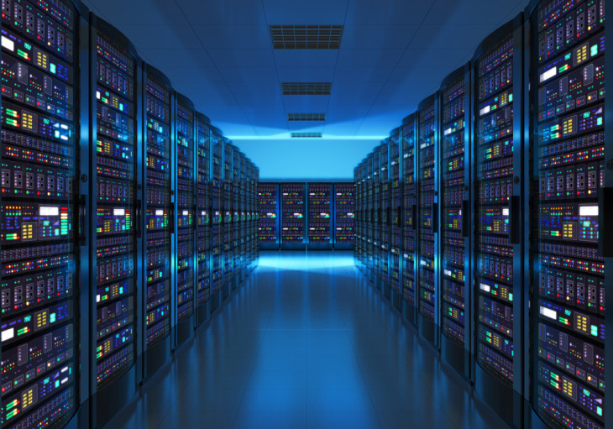
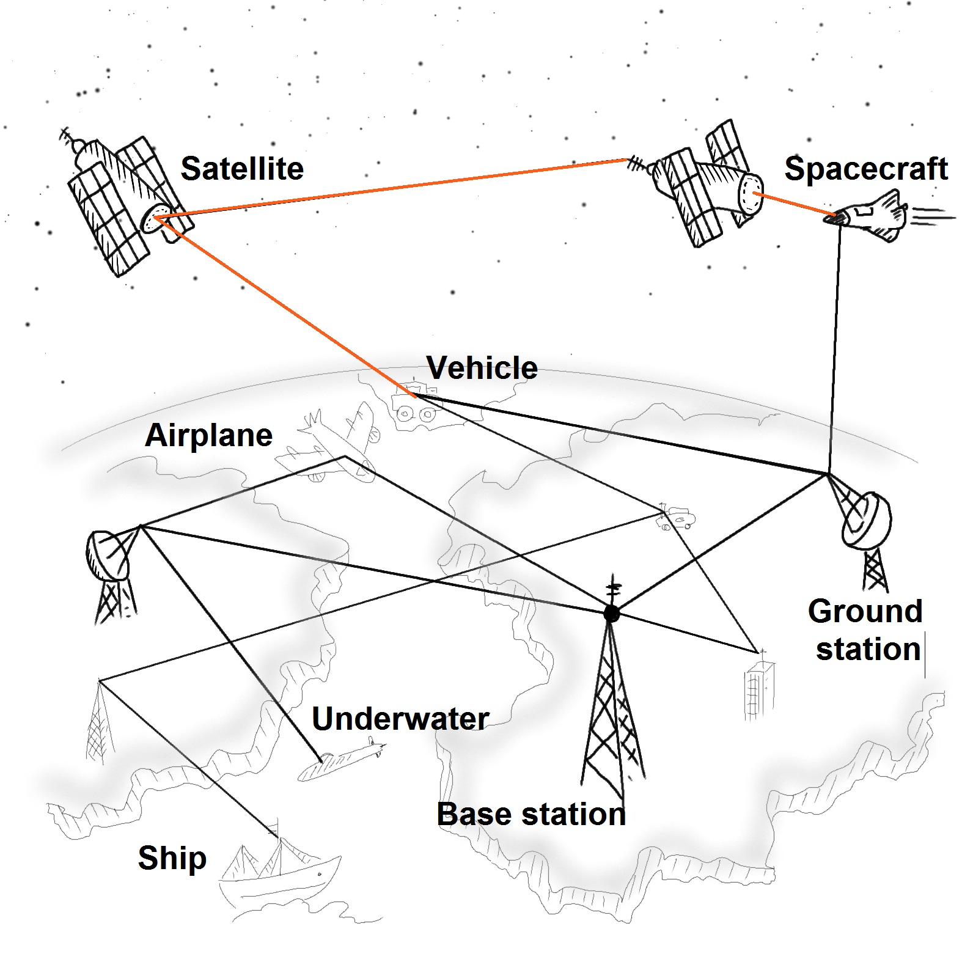
Assets
Communication links – >
Keeping Earth connected to outer space and our space trips
Transferring sensitive Information between different facilities
Data Base – >
Keeps information saved in safe place
Support different services by providing us with the appropriate data related to the service

Slide 7

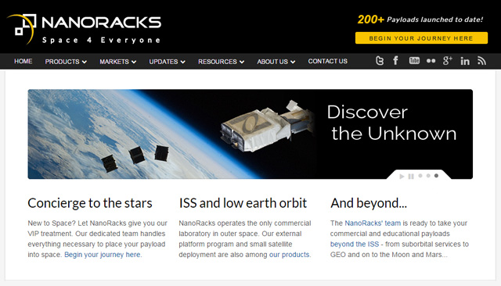
Assets
IT Infrastructure – >
Web services which provide the company and the public with different types of services starting from booking trips and many other services.
Mail services that we developed by our own teams, which provide an internal and external mailing services.

Slide 8
Assets
Security System which is built in a way that it is suppose it be immune against any type of attacks, the Security System is really important to keep it updated and recovered against any type of attacks either a physical or non-physical attack.
the Backup-Links which insure the availability of all system components in our company, our Backup-links are established on Earth and in space to maintain the availability on both Earth and Space

Slide 9
Assets
one of the most important IT-Infrastructure sub-asset is the Independent Payment System that has self security system that is powered with different types that assures the security and privacy of this system.
Employees are considered an important asset for our company, as they are the base we depend on with all our operations inside the Earth and outside the Earth.

Slide 10
Risk Register:
Assets | Threats/ Vulnerability | Existing Controls | Likelihood | Consequence | Level of Risk | Risk priority
Communication links | 1-DDOS 2-Unauthorized-access 3-Man in the middle attacks 4-Human Errors | 1-IDS/IPS 2-Educational Awareness 3-Restricted Access 4-Log Auditing | likely | Major | Extreme | 1
Data-Base | 1-Human Error 2-Surrounding Environment 3-DDOS 4-Misconfigurations 5-Weak Audit Trail | 1-Frequent Updates 2-IDS/IPS 3-Human Training | Possible | Major | Extreme | 2
Web Services & Mail Services | 1-Phishing 2-DDOS 3-Brute Forcing 4-Command Injection | 1-IDS/IPS 2-Training 3-Advanced Firewall | Possible | Moderate | High | 4
Security & Independent Payment System | 1-Power system Attack 2-Fake Physical IDs 3-Masquerade 4-Fraud 5-Spamming 6-Transaction Poisoning | 1-Multi-Factor 2-Authentication 3-Advanced Alarming system 4-24/7 Auditing | Likely | Major | Extreme | 3

Slide 11
Risk Register:
Assets | Threats/ Vulnerability | Existing Controls | Likelihood | Consequence | Level of Risk | Risk priority
Backup-links | 1-Single point of failure 2-Lack of Accountability | 1-Keeping the backup links off the public network 2-Frequent monitoring | Rare | Catastrophic | High | 2
Employees | 1-Social Engineering 2-Workspace Hijacking 3-Lack of Awareness | 1-Educational Awareness 2-Session Timeout 3-Session monitoring 4-Least Privileges | Likely | Major | High | 4
30 30 37 0A

Slide 12
Risk Plan Implementation:
Asset | Communication links
THREATS: | DDOS/ Unauthorized-access / Man in the middle attacks
IMPACTS: | Possible life loss Integrity Damage Loss of reputation
SUGGESTED CONTROLS: | 1) Training 2) Classifying and splitting the channels
SELECTED CONTROLS: | 1 2
REQUIRED ACTIONS: | Training the employees on the new classifying system
RESPONSIBLE PERSON: | Chief Technology Officer

Slide 13
Risk Plan Implementation:
Asset | Data Base
THREATS: | Human Error / Surrounding Environment / DDOS/ Misconfigurations / Weak Audit Trail
IMPACTS: | Financial Damage Data leak Loss of Reputation Data may he held for Ransom
SUGGESTED CONTROLS: | 1) Maintenance and update 2) Training 3) Using IDS and IPS 4) Backups 5) Limited Privileges
SELECTED CONTROLS: | 1 3 4 5
REQUIRED ACTIONS: | Change access credentials in case of an attack Alert all IT employees
RESPONSIBLE PERSON: | Chief Technology Officer / Security Admin

Slide 14
Risk Plan Implementation:
Asset | IT-Infrastructure
THREATS: | DDOS / Fraud / Power System Attack / Spamming
IMPACTS: | Financial Damage Availability DDOS Data Leak
SUGGESTED CONTROLS: | 1) Maintenance & Update 2) Backups 3) Limited Privilege
SELECTED CONTROLS: | 2 3
REQUIRED ACTIONS: | Disabling all unnecessary Privilege Centralized System Alert
RESPONSIBLE PERSON: | Chief Technology Officer / IT Security Manager

Slide 15
Risk Plan Implementation:
Asset | Employees
THREATS: | Social Engineering - Workspace Hijacking - Lack of Awareness
IMPACTS: | Loss of Reputation Financial Damage Loss of Jobs Possible Life Loss
SUGGESTED CONTROLS: | 1) Awareness 2) Limited Privileges 3) Training 4) Background Checks 5) Restricted Policies Related to employees
SELECTED CONTROLS: | 1 2 3 5
REQUIRED ACTIONS: | Constantly monitoring the system using specialized and advanced softwares
RESPONSIBLE PERSON: | IT Security Manager

Slide 16
Thank you for your precious and valuable time

